Slide 1
GROUP - 45
Megabucks
PROJECT EXHIBITION

Slide 2
Table of Contents
01
Problem Statement
02
The Introduction
03
Existing Work with Limitations
04
Proposed Work and Methodology
05
Novelty of the Project
06
Real-Time Usage
07
Hardware and Software Requirements
08
Novelty of the Project
09
Overall System Architecture Design

Slide 3
The Team *()
“Talent wins games, but teamwork and intelligence win championships”
- Michael Jordan

Slide 4
Our Team
KUMAR PRAKHAR
RAJAT KAUSHIK
Reg. No: 19BAI10012
Email ID: kumar.prakhar2019@vitbhopal.ac.in
Reg. No: 19BAI10110
Email ID: rajat.kaushik2019@vitbhopal.ac.in
TEAM
ASHWIN R
FAIZAN MIRZA
Reg. No: 19BAI10132
Email ID: ashwin.r2019@vitbhopal.ac.in
Reg. No: 19BAI10157
Email ID: faizan.mirza2019@vitbhopal.ac.in
Our Guide: Dr. S. Sountharrajan
Email ID: s.sountharrajan@vitbhopal.ac.in

Slide 5

Problem Statement
Before an investor invests in any stock, he needs to be aware how the stock market behaves. Investing in a good stock but at a bad time can have disastrous results, while investment in a mediocre stock at the right time can bear profits. Financial investors of today are facing this problem of trading as they do not properly understand as to which stocks to buy or which stocks to sell in order to get optimum profits.
In this project, we’ll use AutoRegressive Integrated Moving Average (ARIMA) to forecast future stock prices of companies listed at the National Stock Exchange.

Slide 6
Introduction

Slide 7
Stock Market
A stock market, equity market or share market is the aggregation of buyers and sellers of stocks (also called shares), which represent ownership claims on businesses.
Investment in the stock market is most often done via stockbrokerages and electronic trading platforms. Investment is usually made with an investment strategy in mind.
Stocks can be categorized by the country where the company is domiciled. For example, Nestlé and Novartis are domiciled in Switzerland and traded on the SIX Swiss Exchange, so they may be considered as part of the Swiss stock market, although the stocks may also be traded on exchanges in other countries, for example, as American depositary receipts (ADRs) on U.S. stock markets
A stock exchange, securities exchange, or bourse is a facility where stockbrokers and traders can buy and sell securities, such as shares of stock and bonds and other financial instruments. Stock exchanges often function as "continuous auction" markets with buyers and sellers consummating transactions via open outcry at a central location such as the floor of the exchange or by using an electronic trading platform.
$100.50
BUY
SELL
$203.00

Slide 8

National Stock Exchange
National Stock Exchange has a total market capitalization of more than US$2.27 trillion, making it the world's 11th-largest stock exchange as of April 2018.
National Stock Exchange of India Limited (NSE) is the leading stock exchange of India, located in Mumbai, Maharashtra. NSE was established in 1992 as the first dematerialized electronic exchange in the country. NSE was the first exchange in the country to provide a modern, fully automated screen-based electronic trading system which offered easy trading facilities to investors spread across the length and breadth of the country. Vikram Limaye is Managing Director & Chief Executive Officer of NSE.
SELL
BUY
SELL
The key domestic investors include Life Insurance Corporation, State Bank of India, IFCI Limited , IDFC Limited and Stock Holding Corporation of India Limited.
BUY

Slide 9

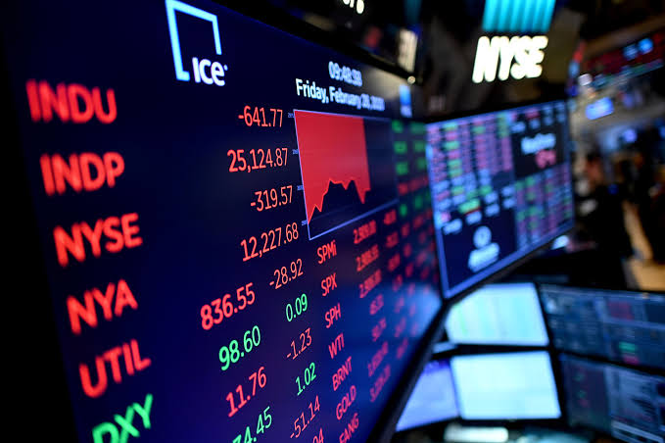
Stock Analysis
What is Stock Analysis?
Stock analysis is a method for investors and traders to make buying and selling decisions. By studying and evaluating past and current data, investors and traders attempt to gain an edge in the markets by making informed decisions.
2 types of Analysis
Fundamental Analysis
Technical Analysis
Is it helpful?
Fundamental and Technical
Fundamental analysis concentrates on data from sources, including financial records, economic reports, company assets, and market share.
Technical analysis focuses on the study of past and present price action to predict the probability of future price movements.
Both fundamental and technical analysis can be done independently or together. Either way, using stock analysis, it’s important for investments.

Slide 10

Existing Work with Limitations
Stock price prediction is an important topic in finance and economics which has spurred the interest of researchers over the years to develop better predictive models. (Ayodele Ariyo Adebiyi from Covenant University Ota Ogun State, Nigeria) (Aderemi Adewumi from University of KwaZulu-Natal )(Charles Ayo Covenant University Ota Ogun State, Nigeria) presented their paper at 2014 UKSim-AMSS 16th International Conference on Computer Modelling and Simulation which contained information about extensive process of building stock price predictive model using the ARIMA model. Published stock data obtained from New York Stock Exchange (NYSE) and Nigeria Stock Exchange (NSE) were used with stock price predictive model developed. Results obtained revealed that the ARIMA model has a strong potential for short-term prediction and can compete favourably with existing techniques for stock price prediction.
Requires a lot of time series observations.
Requires a stationary data series.
The forecast is determined only by the past behaviour of the variable.

Slide 11
Algorithmic Trading
Algorithmic trading is a method of executing orders using automated pre-programmed trading instructions accounting for variables such as time, price, and volume. This type of trading was developed to make use of the speed and data processing advantages that computers have over human traders.
Popular "algos" include Percentage of Volume, Pegged, VWAP, TWAP, Implementation shortfall and Target close. In the twenty-first century, algorithmic trading has been gaining traction with both retail and institutional traders.
It is widely used by investment banks, pension funds, mutual funds, and hedge funds that may need to spread out the execution of a larger order or perform trades too fast for human traders to react to.
A study in 2016 showed that over 80% of trading in the FOREX market was performed by trading algorithms rather than humans
Basic models can rely on as little as a linear regression, while more complex game-theoretic and pattern recognition or predictive models can also be used to initiate trading. More complex methods such as Markov chain Monte Carlo have been used to create these models.
442.13
369.73
228.61
360.21
225.33
198.69
200.11
Increasingly, the algorithms used by large brokerages and asset managers are written to the FIX Protocol's Algorithmic Trading Definition Language (FIXatdl), which allows firms receiving orders to specify exactly how their electronic orders should be expressed.

Slide 12
Infographic Style
GreenKey Technologies’ AI for trading uses speech recognition and natural language processing technology to save traders time searching through conversions, financial data and notes. With the company’s platform, financial professionals are using AI to sift through, and access, notes, market insights and trending companies in real-time.
AI in Stock Markets
AI is shaping the future of stock trading. Using AI, robo-advisers analyse millions of data points and execute trades at the optimal price, analysts forecast markets with greater accuracy and trading firms efficiently mitigate risk to provide for higher returns.
How it’s using AI in trading: Through its acquisition of Neurensic, Trading Technologies now has an AI platform that identifies complex trading patterns on a massive scale across multiple markets in real time. Combining machine learning technology with high-speed, big data processing power, the company provides clients with an ongoing assessment of compliance risk.
“Machine learning is evolving at an even quicker pace and financial institutions are one of the first adaptors,” Anthony Antenucci, vice president of global business development at Intelenet Global Services, recently said.

Slide 13

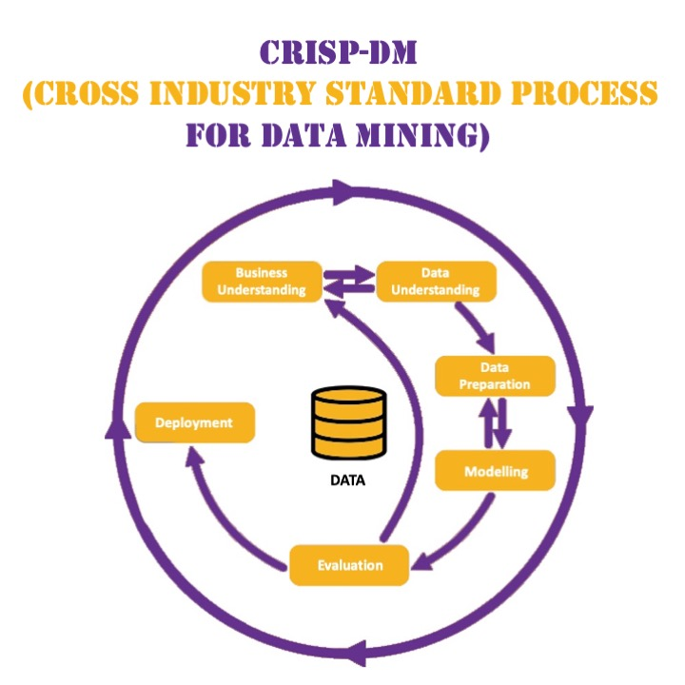
Proposed Work & Methodology
We will do Time Series Analysis using ARIMA in Python to forecast future closing prices of a stock based on historical stock data.
We will then build an android app using Flutter framework which will display the results to the end user, using which he can make decisions regarding investing in the stock market.

Slide 14
Novelty of the Project
PROFIT
During the lockdown, many people started investing in the stock markets to supplement their incomes and benefit from the lower prices of stocks due to the lockdown.
The ability to make predictions based upon historical observations creates a competitive advantage. For example, if an individual has the capacity to better forecast the future prices of a stock, he will be in a more favorable position to optimize his portfolio. This can result in increased returns from the market, decrease nonperforming stocks in the portfolio and improved earnings of the investor.
LOSS
Through this project we will give the investor the data using which he can make decisions regarding investment in the stock market.

Slide 15
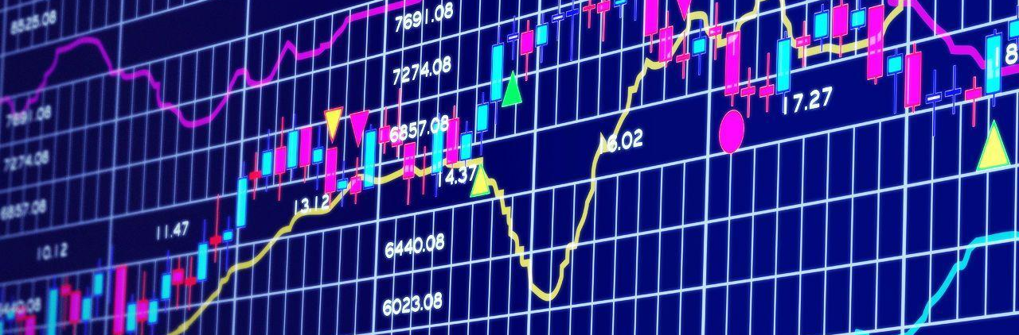
The app will perform web scraping to collect historical real time stock market data from the National Stock Exchange Website.
Based on that data the app will predict possible future trends and prices of the stock.
An investor can use this data to make more informed decisions before investing in the stock market.
Real Time Usage
Disclaimer: Stock markets prices vary based on many factors, this app only analyses historical stock market data. Inaccuracies may arise in predictions; investor discretion is advised.

Slide 16
Hardware & Software Requirements
Figma (Wireframe)
Text Editor (VS Code)
Flutter Framework
Web Browser with Chromium Engine
Android Virtual Device (Android Studio)
Firebase Console
Programming Languages used –
Dart for App Development
Python for Data Analysis
Python Libraries used –
nsepy, pmdarima, sklearn, datetime, statsmodels, mathplotlib, pandas, numpy, etc
Note:- Our project is completely based on software and does not need any specialised hardware.

Slide 17
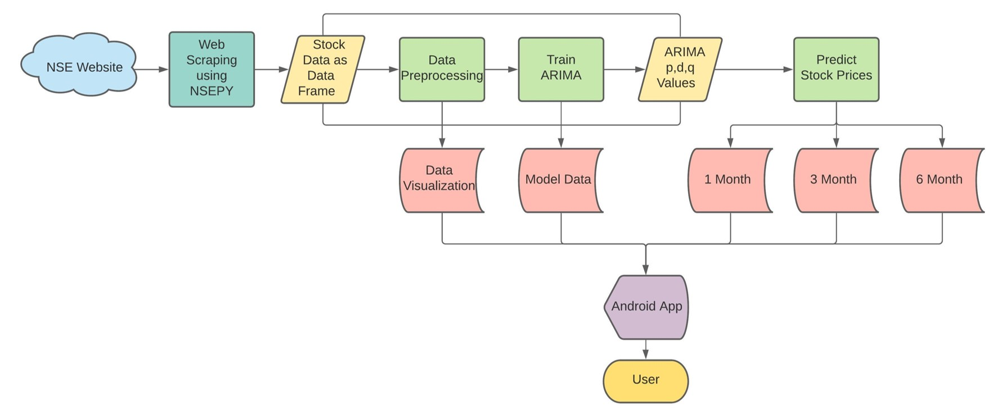
Overall System Architecture Diagram

Slide 18
First Review
Continuation of Zeroth Review

Slide 19
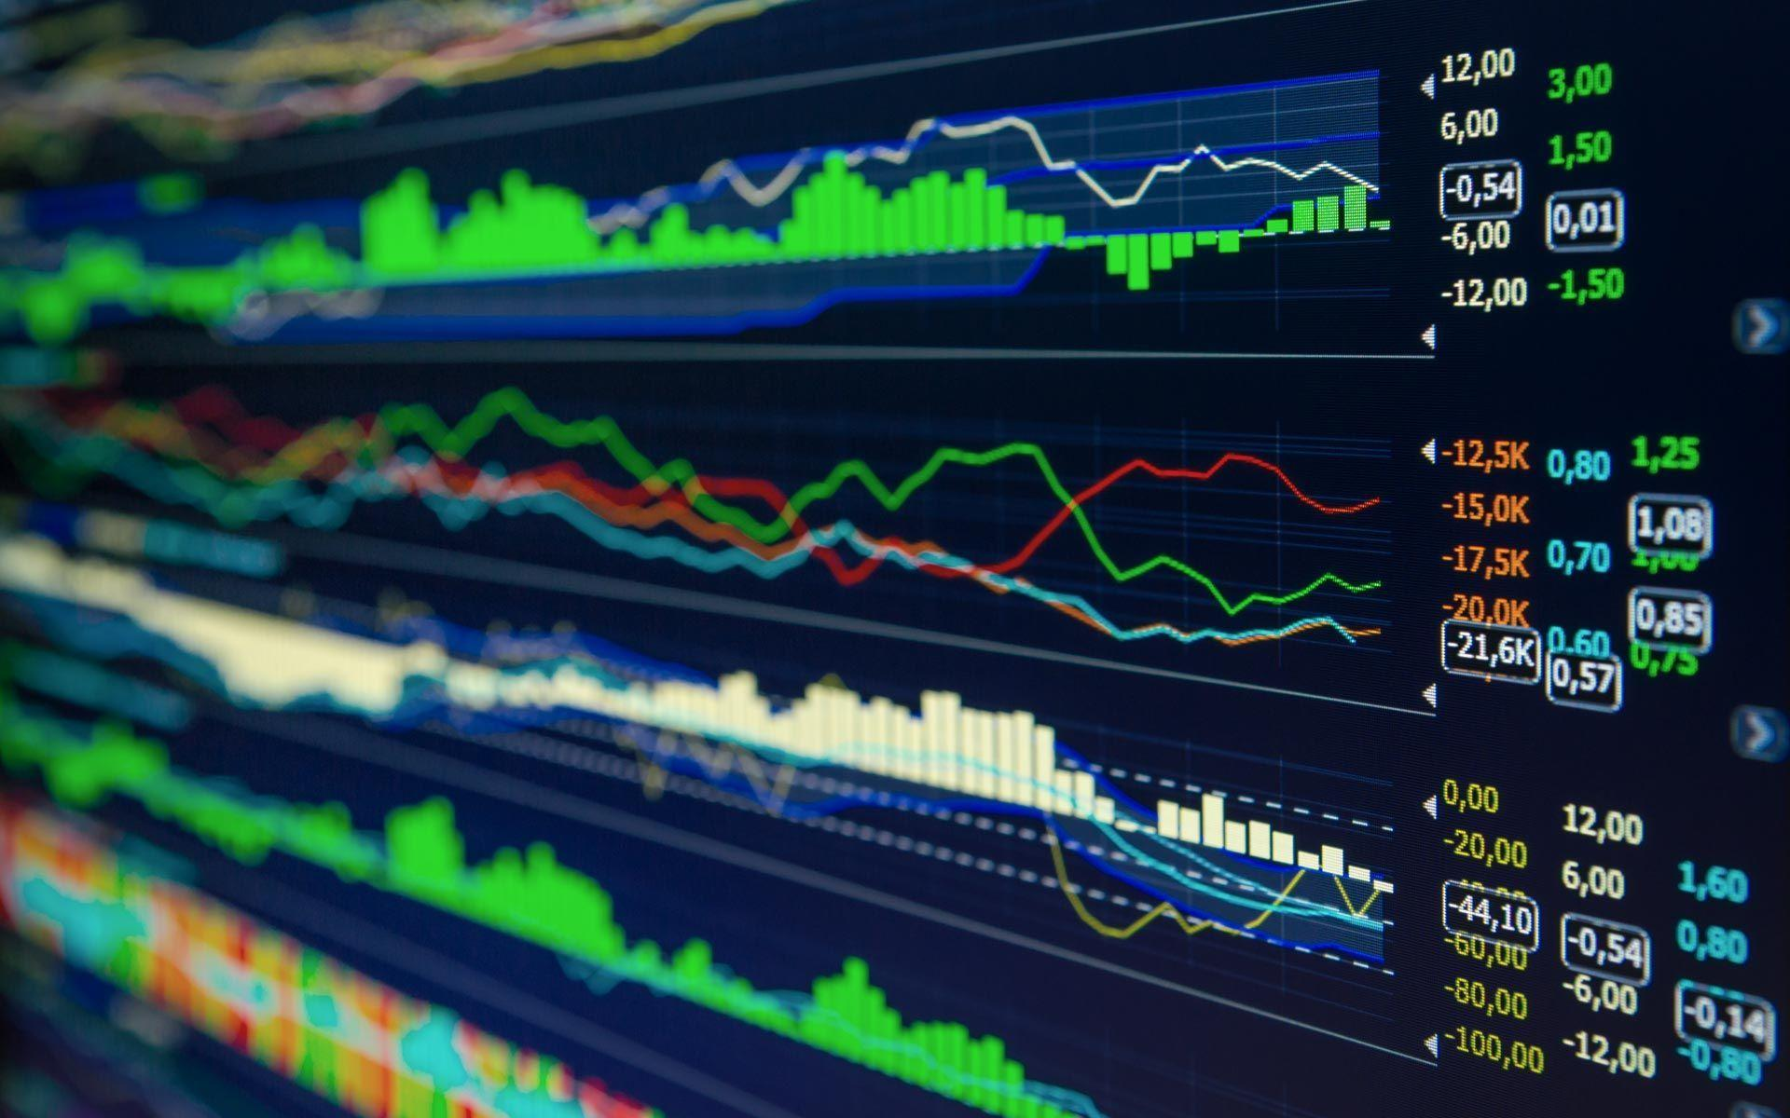
Literature Review
The concept behind how the stock market works is pretty simple. Operating much like an auction house, the stock market enables buyers and sellers to negotiate prices and make trades.
The stock market works through a network of exchanges — you may have heard of the New York Stock Exchange, Nasdaq or Sensex. Companies list shares of their stock on an exchange through a process called an initial public offering or IPO.
Links:
https://www.kdnuggets.com/2020/01/stock-market-forecasting-time-series-analysis.html
https://towardsdatascience.com/time-series-forecasting-predicting-stock-prices-using-an-arima-model-2e3b3080bd70
https://blog.quantinsti.com/forecasting-stock-returns-using-arima-model/

Slide 20
Module Description
Moving Average (MA)
The dependency between an observation and a residual error from a moving average model applied to lagged obs.
In short, I is the data values are replaced by the difference between the data values and the previous values.
Each component functions as a parameter with a standard notation. For ARIMA models, a standard notation would be ARIMA with p, d, and q, where integer values substitute for the parameters to indicate the type of ARIMA model used. The parameters can be defined as:
p: lag order.
d: degree of differencing.
q: order of the moving average.
Integrated (I)
ARIMA models are applied in some cases where data show evidence of non-stationarity, where an initial differencing step (corresponding to the "integrated" part of the model) can be applied one or more times to eliminate the non-stationarity.
Represents the differencing of raw observations to allow for the time series to become stationary.
Autoregression (AR)
In short, ARIMA means it is a linear regression model that uses its own lags as predictors. Linear regression models, as you know, work best when the predictors are not correlated and are independent of each other.
Shows a changing variable that regresses on its own lagged, or prior, values.

Slide 21
ARIMA Model
In statistics and econometrics, and in time series analysis, an autoregressive integrated moving average (ARIMA) model is a generalization of an autoregressive moving average (ARMA) model. Both models are fitted to time series data either to better understand the data or to predict future points in the series (forecasting). ARIMA models are applied in some cases where data show evidence of non-stationarity, where an initial differencing step (corresponding to the "integrated" part of the model) can be applied one or more times to eliminate the non-stationarity.
Three integers (p, d, q) are typically used to parametrize ARIMA models.
p: number of autoregressive terms (AR order)
d: number of nonseasonal differences (differencing order)
q: number of moving-average terms (MA order)

Slide 22
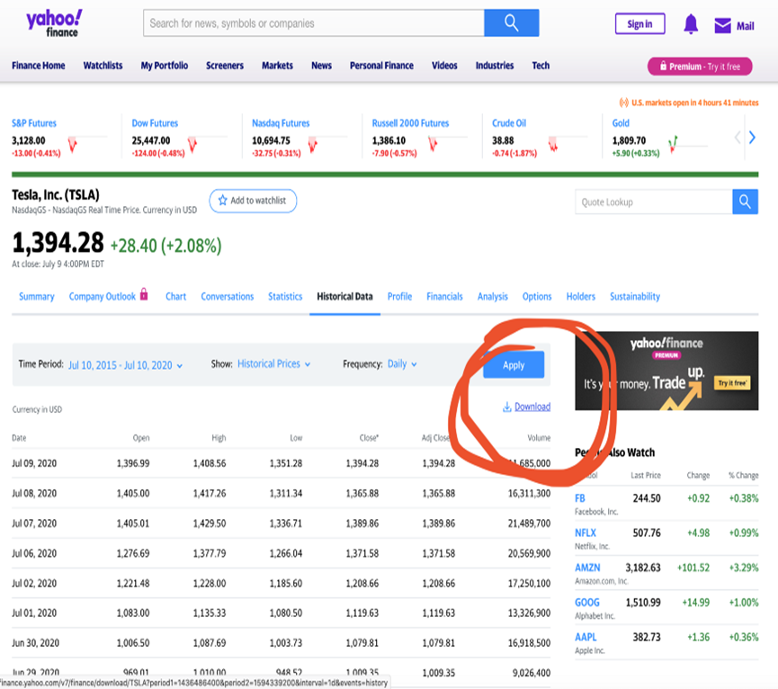
Overall Analysis of ARIMA
This analysis using ARIMA lead overall to appreciable results. This model demonstrated in fact to offer good prediction accuracy and to be relatively fast compared to other alternatives such as RRNs (Recurrent Neural Networks).
ARIMA can lead to particularly good results if applied to short time predictions (like has been used in this example)
We can use the summary function to confirm the results of the ARIMA model are within acceptable limits. In the last part, we append every forecasted return and the actual return to the forecasted returns series and the actual returns series respectively.
Thanks to Yahoo finance we can get the data for free. Use the following link to get the stock price history of TESLA:
https://finance.yahoo.com/quote/TSLA/history?period1=1436486400&period2=1594339200&interval=1d&filter=history&frequency=1d

Slide 23
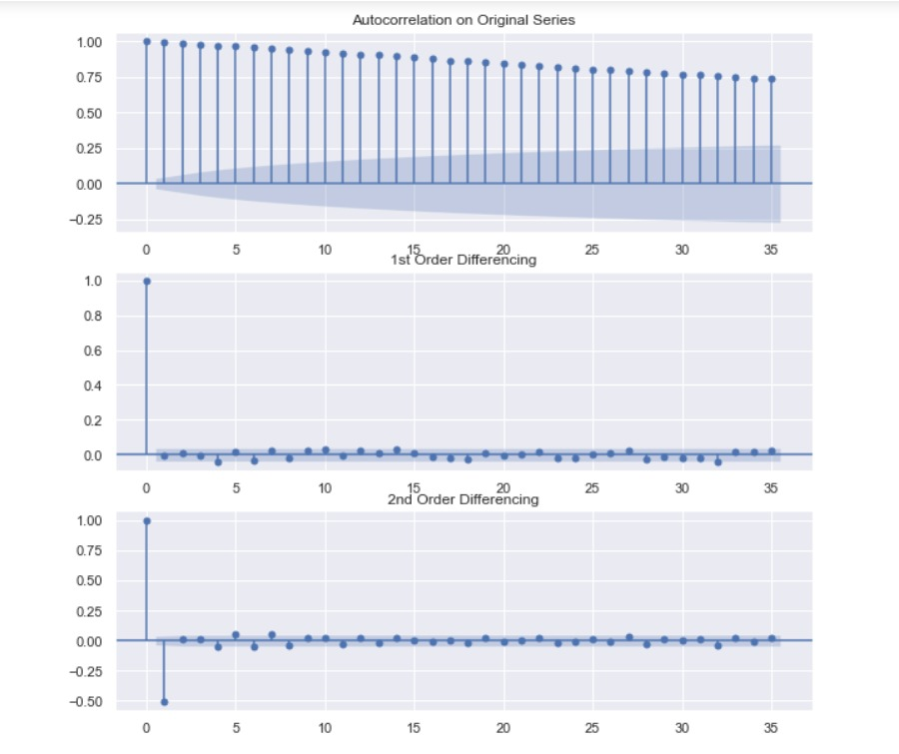
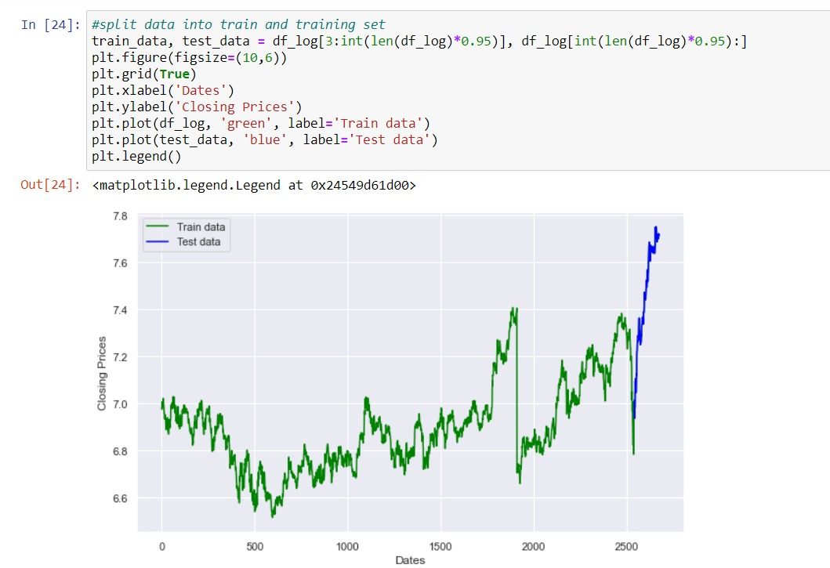
Prediction Graphs

Slide 24
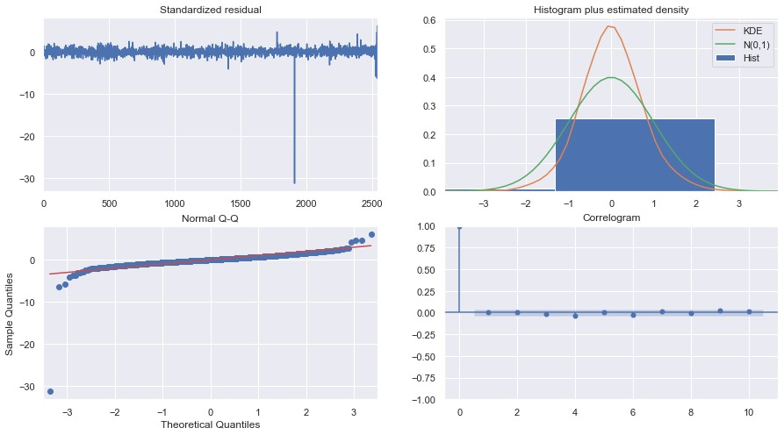
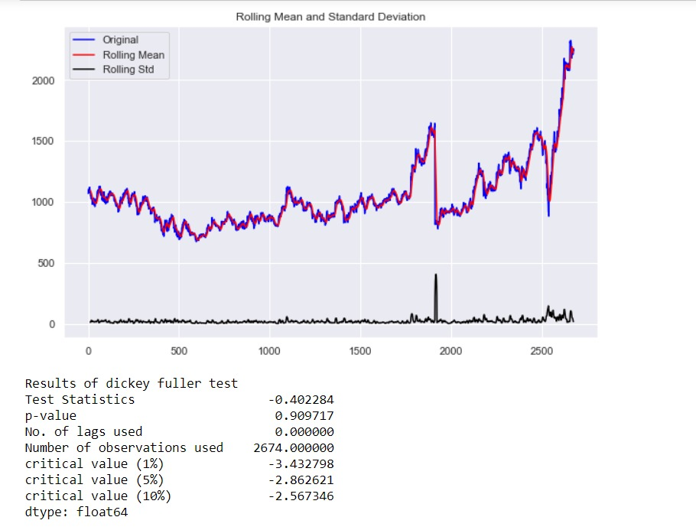

Slide 25
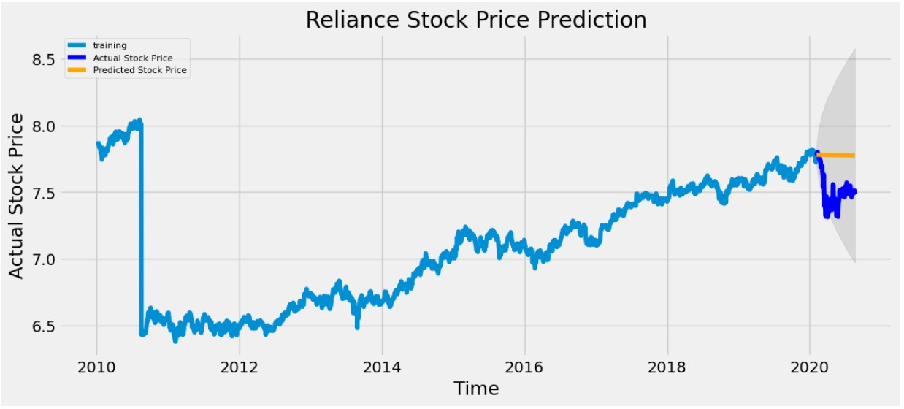
Reliance Stock Prediction

Slide 26
Implementation Strategy
Task Name | Task Description | Technology Outlook | Technology Required
Start Up Page | Build a start up page which will automatically redirect the user to the login page after the app loads. The page should also contain a disclaimer regarding the app. | App Development | Flutter Framework, Dart Programming Language
Login Page | Build a login page where user will input his credentials to login to the app. A form will verify credentials from user database, if credentials are right, it will redirect to the home page. A button will redirect user to the sign up page on click. | App Development, Authentication | Flutter Framework, Dart Programming Language, Firebase Console
Sign Up Page | Build a sign up page which will allow user to input credentials to sign up to the app. A form will collect user data and store it in user database and then redirect the user to Thank you page. | App Development, DBMS | Flutter Framework, Dart Programming Language, Firebase Console
Thank You Page | Build a Thank You page which will display a thankyou message to the user for signing into the app. A button will redirect user to the login page. | App Development | Flutter Framework, Dart Programming Language

Slide 27
Implementation Tools
Azure
Flutter
It is a cloud computing service created by Microsoft for building, testing, deploying, and managing applications and services through Microsoft-managed data centres. It supports many different programming languages, tools, and frameworks, including both Microsoft-specific and third-party software and systems.
Flutter is an open-source UI software development kit created by Google. It is used to develop applications for Android, iOS, Linux, Mac, Windows, Google Fuchsia, and the web from a single codebase.
Flask API
BUY
SELL
Azure for Python
Flask API is a drop-in replacement for Flask that provides an implementation of browsable APIs similar to what Django REST framework provides.
It gives you properly content negotiated-responses and smart request parsing.
flaskapi.org for details.
Quickly and easily build, train, host and deploy models from any Python environment with Azure services for data science and machine learning. Or bring in pre-built AI solutions to deliver cutting-edge experiences to your Python apps.
Firebase
Firebase for Background Dev
Firebase is a platform developed by Google for creating mobile and web applications. It was originally an independent company founded in 2011. In 2014, Google acquired the platform and it is now their flagship offering for app development.
Firebase provides the best back-end server, great database and analytics solution, and useful integrations with other Google products. Most of all, it's free.

Slide 28

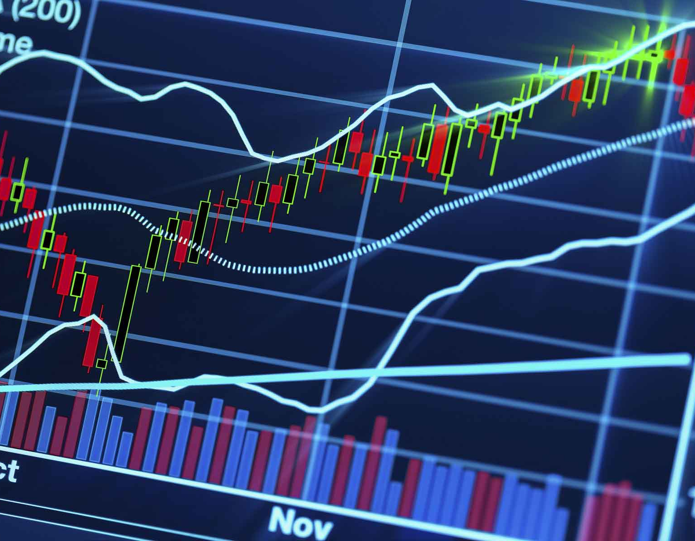
App Development using Flutter Framework
Flutter is an open-source UI software development kit created by Google. It is used to develop applications for Android, iOS, Linux, Mac, Windows, Google Fuchsia and the web from a single codebase.
Flutter's engine, written primarily in C++, provides low-level rendering support using Google's Skia graphics library. Additionally, it interfaces with platform-specific SDKs such as those provided by Android and iOS.

Slide 29
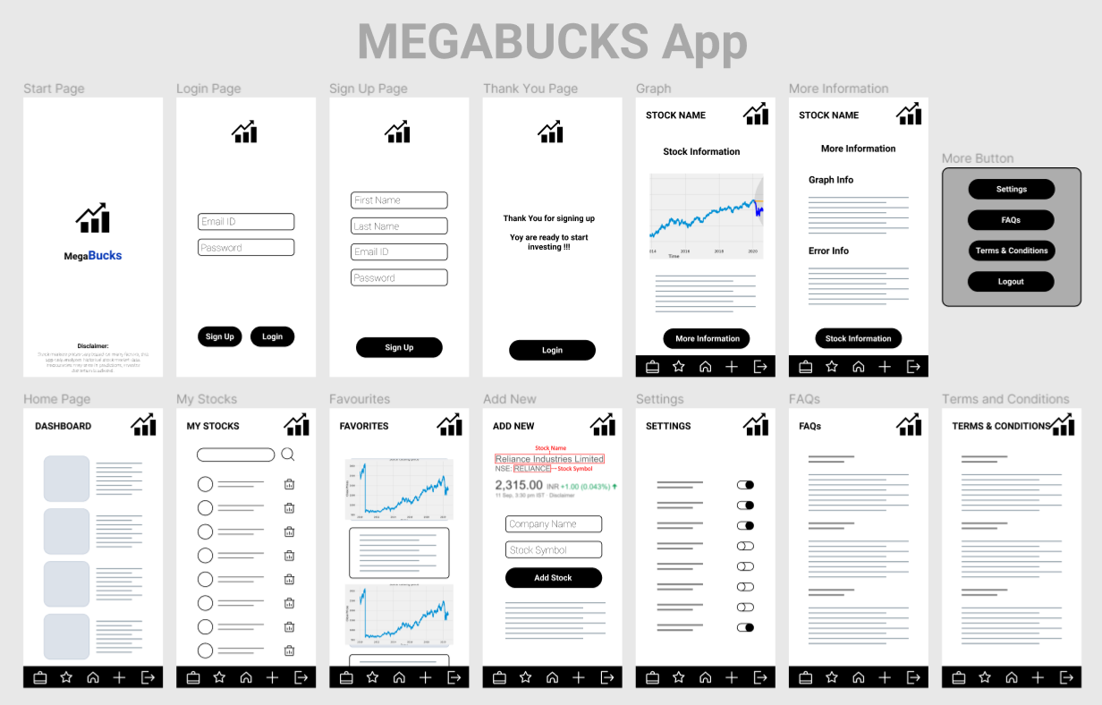
Application Wireframe

Slide 30

App Layout

Slide 31
SOURCES
ARIMA –
https://machinelearningmastery.com/arima-for-time-series-forecasting-with-python/#:~:text=ARIMA%20is%20an%20acronym%20that,time%20series%20forecasting%20in%20Python
https://en.wikipedia.org/wiki/Autoregressive_integrated_moving_average
https://towardsdatascience.com/machine-learning-part-19-time-series-and-autoregressive-integrated-moving-average-model-arima-c1005347b0d7
Flutter –
https://flutter.dev/
https://en.wikipedia.org/wiki/Flutter_(software)
Stock Market Information –
https://en.wikipedia.org/wiki/Stock_market
https://builtin.com/artificial-intelligence/ai-trading-stock-market-tech
https://www.investopedia.com/ask/answers/difference-between-shares-and-stocks/
https://www.investopedia.com/articles/investing/082614/how-stock-market-works.asp
https://en.m.wikipedia.org/wiki/Algorithmic_trading#Strategy_implementation

Slide 32
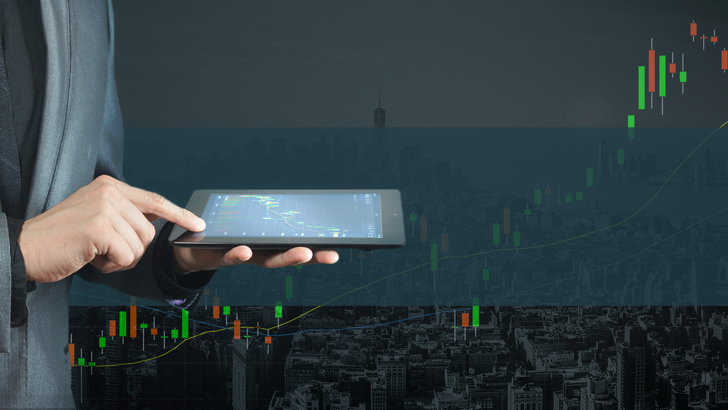
Thank You

